Slide 1

Gas Leak Alert through Smart Phone (Combined with Automatic Door Opening and Fan Activation)
Lecturer: Lê Trung Quân
Team Members:
Phạm Thùy Dung - 20521214
Đậu Đình Quang Anh - 20521059

Slide 2
Table of Contents
01
02
03
04
Introduction
Structure
Demo
Conclusion

Slide 3
01
Introduction

Slide 4
Current Situation in HCM city:
In 2023, Ho Chi Minh City : occurs 498 fires, property damage: about 8.06 billion VND.
Main areas: residential areas, communities, as well as in manufacturing facilities, warehouses, and transportation vehicles
Notes:
In 2023, Ho Chi Minh City experienced 498 fires, with estimated property damage amounting to about 8.06 billion VND. Compared to 2022, the number of fires decreased by 137 incidents, but there was an increase of 2 fatalities. Minor fires continued to concentrate in residential areas, communities, as well as in manufacturing facilities, warehouses, and transportation vehicles.
Therefore, that is reason why my team want to develop the simulation of the gas alert to

Slide 5



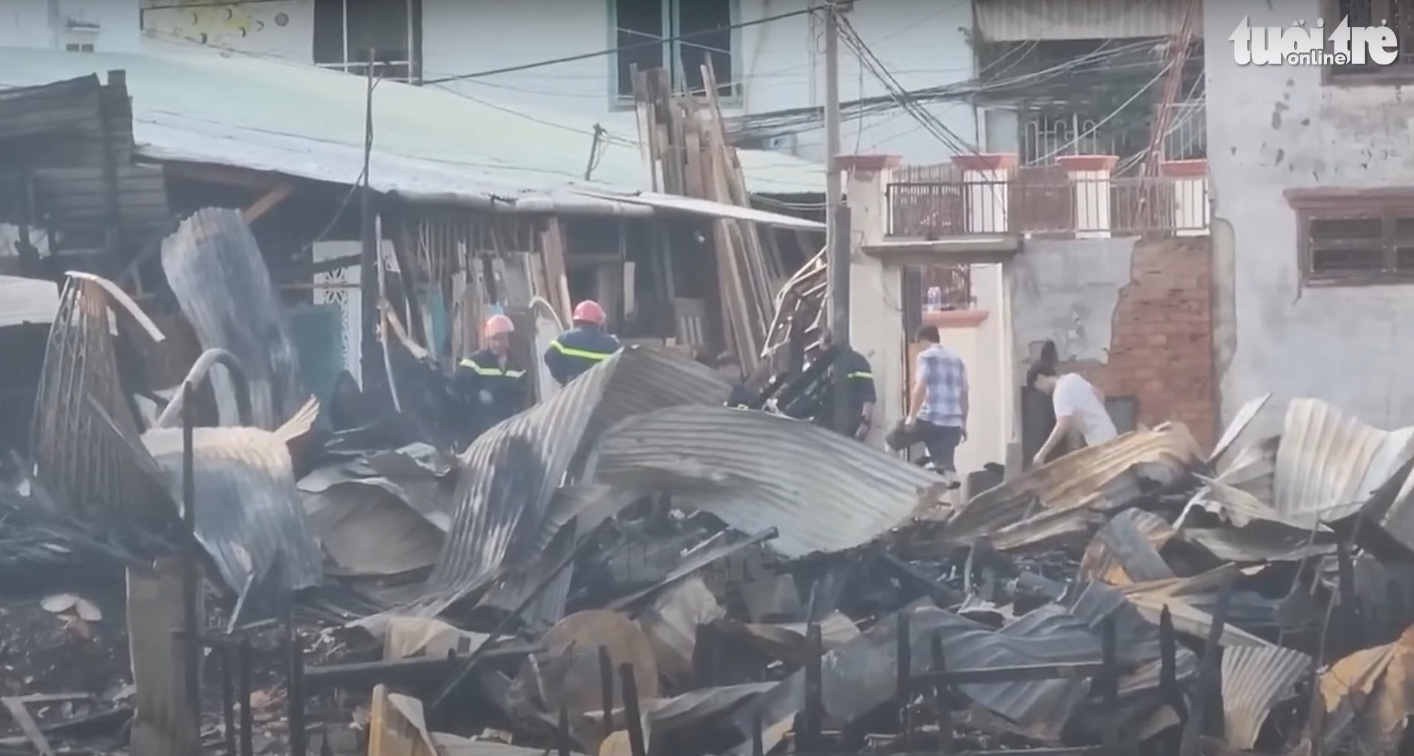
In the middle night of April 1st, Houses along the canal on Pham The Hien street, ward 2, district 8, Ho Chi Minh City.

Slide 6
Purpose:
Detect Gas Leaks
Alert Residents and Workers
Activate Safety Measures
Integrate with Smart Home Systems
Notes:
The topic "Gas Leak Alert through Smart Phone (Combined with Automatic Door Opening and Fan Activation)" suggests the development of a safety feature that uses smart technology to detect gas leaks and respond proactively to reduce the risk of gas-related accidents in homes or industrial settings. Here's a potential purpose for this topic:
Purpose:
The purpose of this technology is to enhance household and industrial safety by providing an immediate and automated response to gas leaks. By leveraging smart phone technology, the system aims to:
Detect Gas Leaks: Utilize advanced sensors that can identify gas leaks swiftly and accurately.
Alert Residents and Workers: Send instant notifications to smart phones when a gas leak is detected, allowing for quick evacuation and response.
Activate Safety Measures: Automatically open doors to facilitate evacuation and air out the premises, while also activating fans to disperse the gas and mitigate its concentration.
Integrate with Smart Home Systems: Work in conjunction with existing smart home or industrial automation systems to coordinate an effective response without human intervention.
Record and Analyze Data: Keep logs of incidents for further analysis and preventive measures.
This system would serve to significantly reduce the hazards associated with gas leaks, potentially saving lives and property by providing a timely and efficient response.

Slide 7


Structure

Slide 8
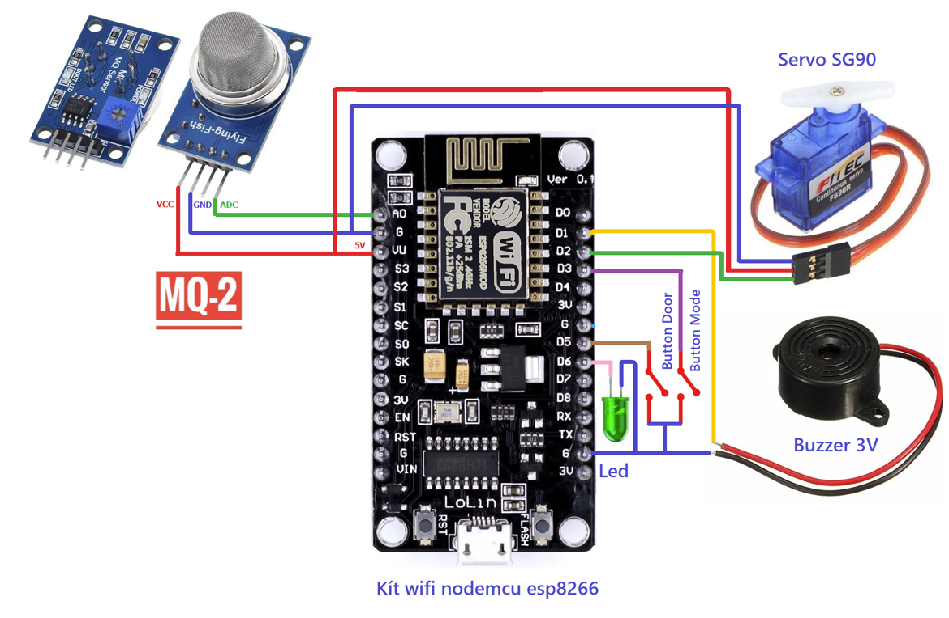



Hardware Connection Diagram

Slide 9
Implementation Diagram
Input
Process
Output
User Interface
Controller Board
Led
Buzzer
Blynk App
Button Mode
ESP8266
Relay Module
Blynk Web
MQ2
Fan
Alert message via Email
Lighter Gas
Battery
Door Button
Power Supply from Laptop
Servo Motor

Slide 10
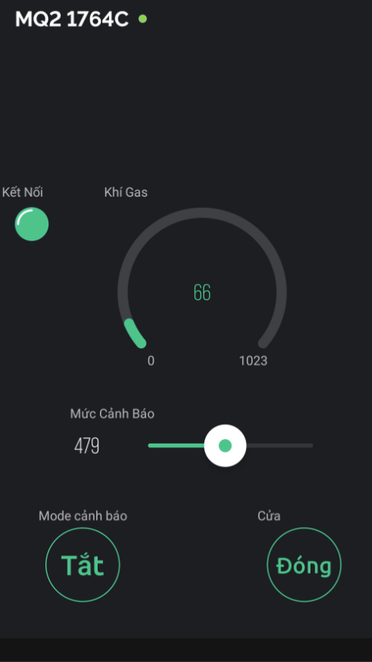
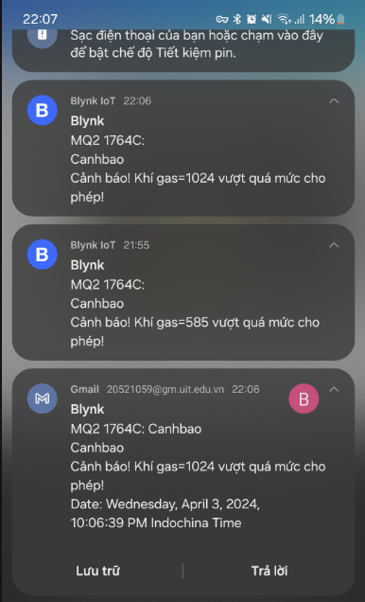
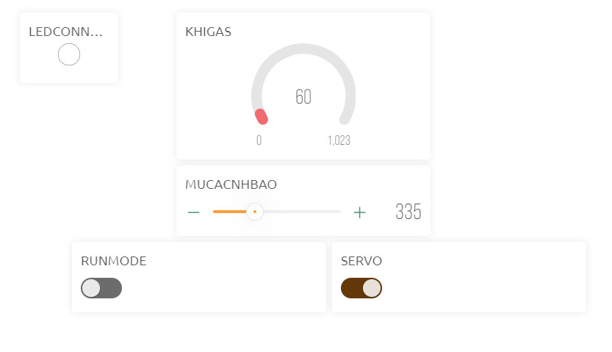
Blynk DashBoard

Slide 11
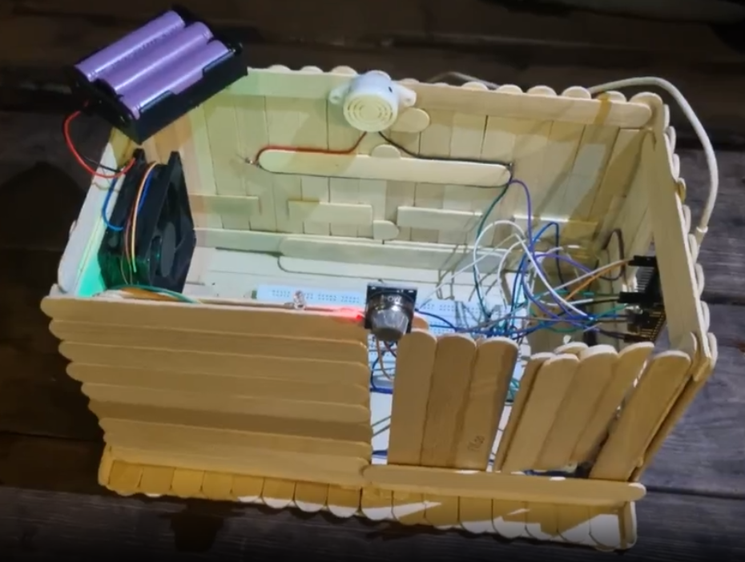
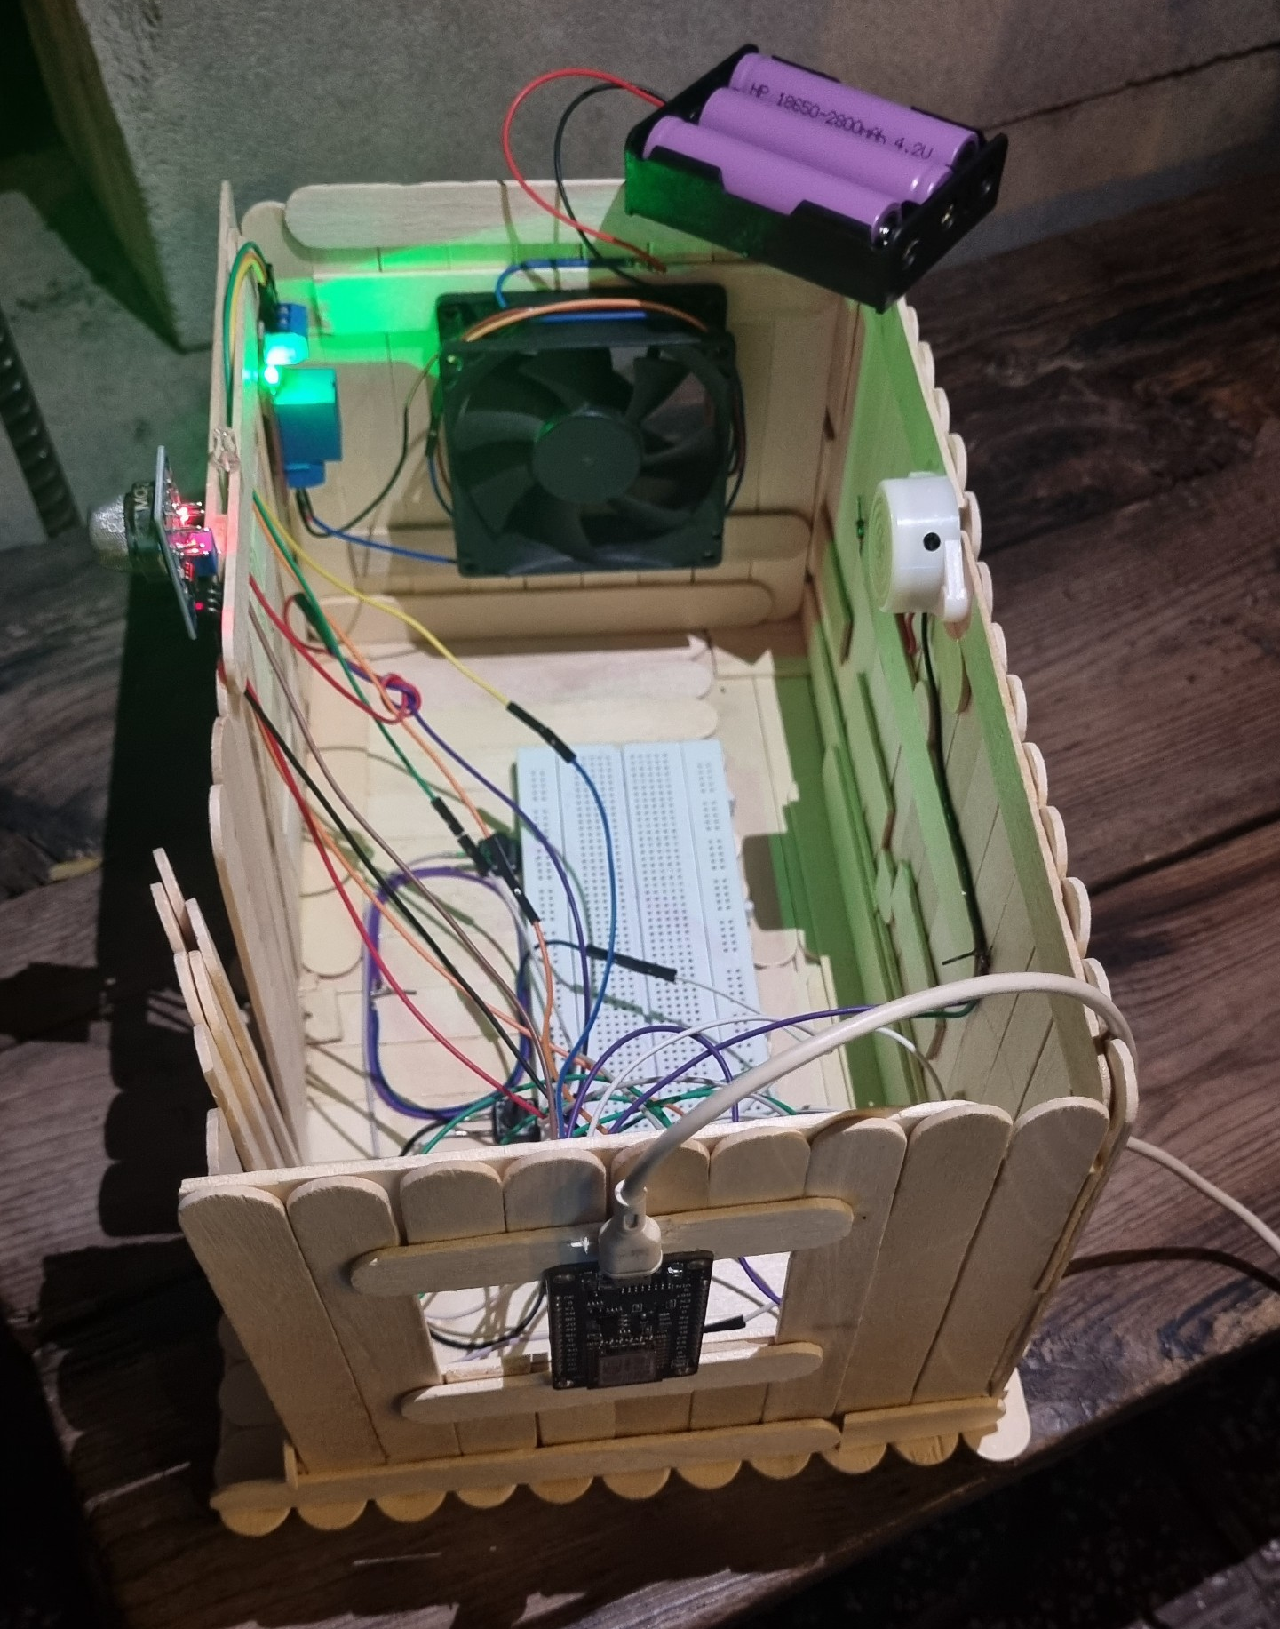
REAL-LIFE IMAGES

Slide 12

DEMO

Slide 13
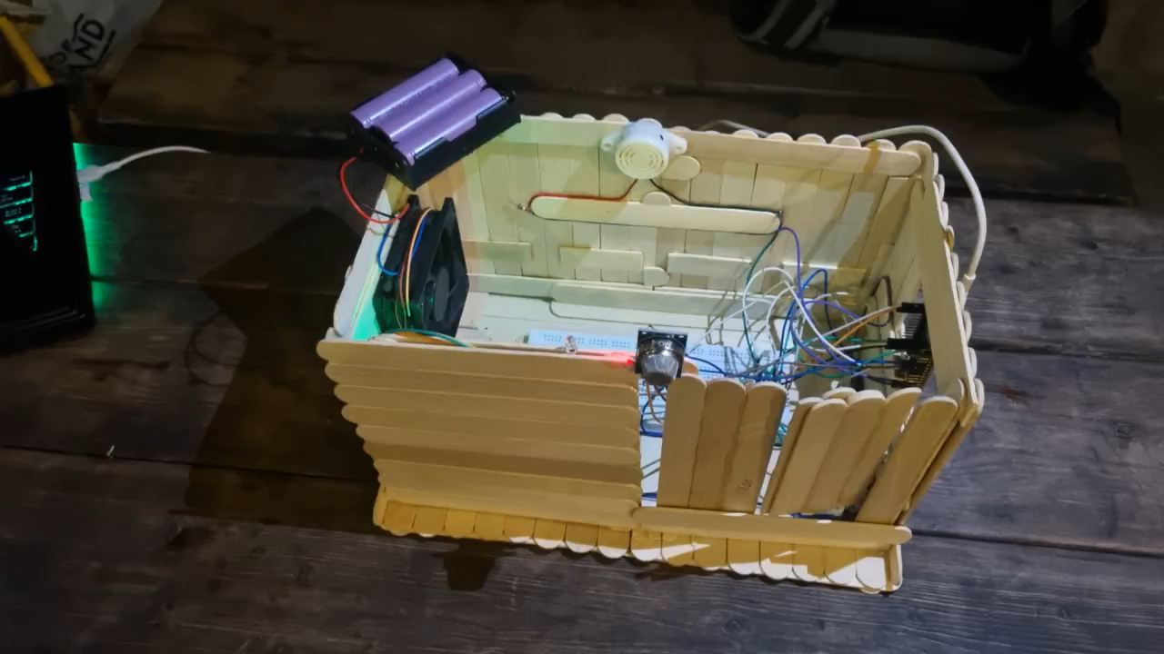

Slide 14
04
Conclusion

Slide 15
Summary:
Automated Response
Smart Phone Integration
Integrated Safety System
Future Development:
Integration with Smart Home Ecosystems
GPS Integration
Machine Learning & Predictive Analysis
Enhanced Communication Protocols
Notes:
Summary with Main Ideas
Integrated Safety System: A gas leak alert system combined with smartphone notifications, automatic door opening, and fan activation enhances safety by providing a quick response to gas leaks.
Smartphone Integration: Utilizes smartphones for real-time alerts, ensuring individuals are informed of gas leaks immediately, regardless of their location.
Automated Response: Automatic door opening and fan activation help to disperse gas, reducing the risk of concentration and potential explosions.
Detailed Content with Bullet Points
Integrated Safety System
Combines gas detection, alerting, and automated physical responses.
Improves safety by minimizing human intervention and reaction time.
Smartphone Integration
Sends instant notifications to users’ smartphones about gas leaks.
Allows for remote monitoring and control of the safety system.
Automated Response
Doors automatically open to facilitate ventilation and safe exit routes.
Fans are activated to help disperse gas and lower its concentration in the air.
Future Developments
Advanced Sensor Technology
Utilize more sensitive and accurate sensors.
Reduce false alarms and adapt to varying environmental conditions.
Machine Learning and Predictive Analysis
Implement algorithms to predict leaks and automate preventive measures.
Integration with Smart Home Ecosystems
Ensure compatibility with other smart devices for a holistic safety approach.
Enhanced Communication Protocols
Develop secure and reliable communication channels to prevent cyber threats.
GPS Integration
Incorporate GPS to pinpoint leak locations, aiding prompt emergency response.
Energy Efficiency and Sustainability
Focus on reducing the system’s energy consumption.
Promote the use of renewable energy sources for sustainability.

Slide 16
Reference
[1] https://danviet.vn/tphcm-nam-2023-xay-ra-498-vu-chay-thiet-hai-806-ty-dong-20240107190501889.htm
[2] https://youtu.be/AXZA4B_aboY?si=lSQjrkK8kYCDyQHd
[3] https://www.academia.edu/78359913/IOT_Based_Industrial_Plant_Safety_Gas_Leakage_Detection?uc-g-sw=44832821

